Slide 1
Welcome to Session 1
This session will take approximately 1.5 – 2 hours, including multiple breaks.
IMPORTANT before starting, make sure:
You will NOT be distracted within the next 2 hours
Your cell phone is turned off
Please confirm with the experimenter that you have entered the correct Session # and Participant ID before pressing the Start Experiment button.

Slide 2
Experiment Overview
The experiment has 4 main sections:
Practice – Learn how to navigate in a virtual environment and collect money
Bonus Pay – All money collected in this round you will keep
Find The Trophy – Locate the trophy as fast as you can
Experiment Survey – Tell us what you thought about the experiment
Please make sure to listen to each instruction carefully and wait for the experimenter to instruct you to proceed to the next instruction.
Don’t be afraid to ask questions if you need clarification!
Do you have any questions?

Slide 3
Section 1: Practice!
In this section you will learn how to navigate a virtual environment and how to find money within it.
Use this Practice Section to learn as much as possible about collecting money. This will help you to earn the most Bonus Pay in the next Section!
Do you have any questions?

Slide 4
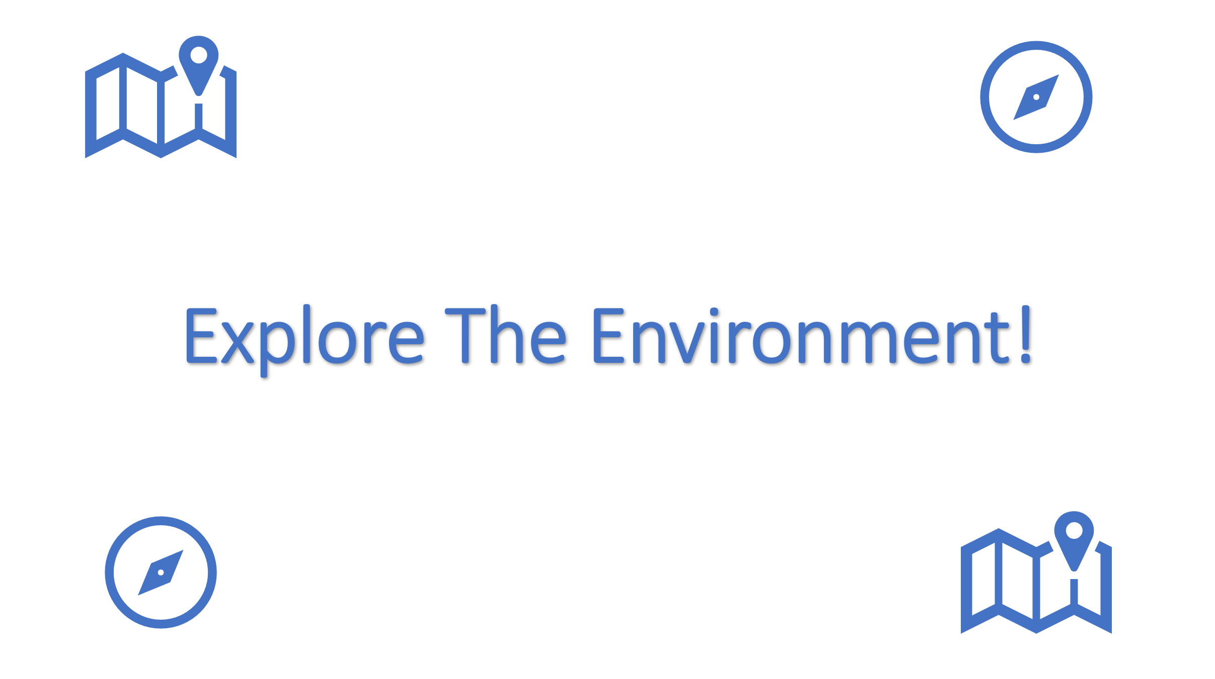
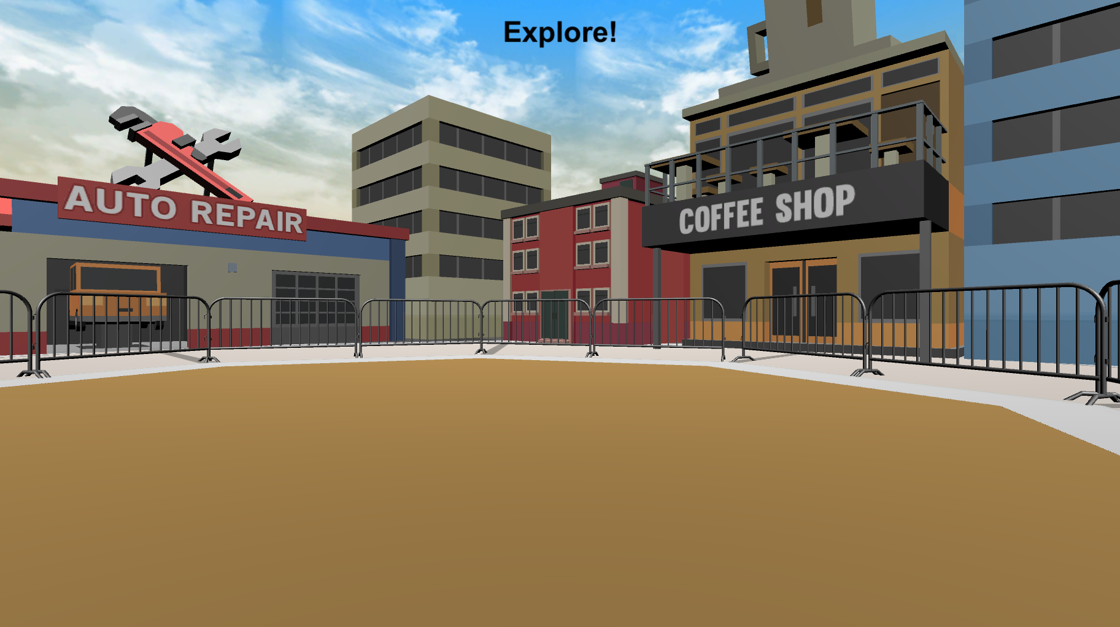
Section 1: Practice
Before looking for money, you will have the opportunity to explore the environment. On each Explore Round you will see the Explore The Environment screen (left bottom) and then you will be placed into the environment at a random location (right bottom). There is no money to collect in these rounds, so just move around and learn as much as you can about the environment.
Press Spacebar to continue …

Slide 5
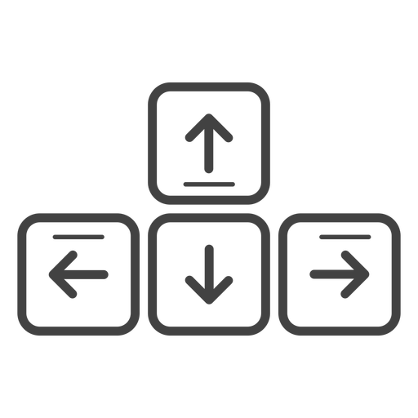
Section 1: Practice
MOVEMENT CONTROLS
To move around the environment, you can ONLY use the Up-Arrow to move forward, and the left and right arrow-keys to rotate.
Move Forward
Rotate
Left
Rotate
Right
Do you have any questions?

Slide 6
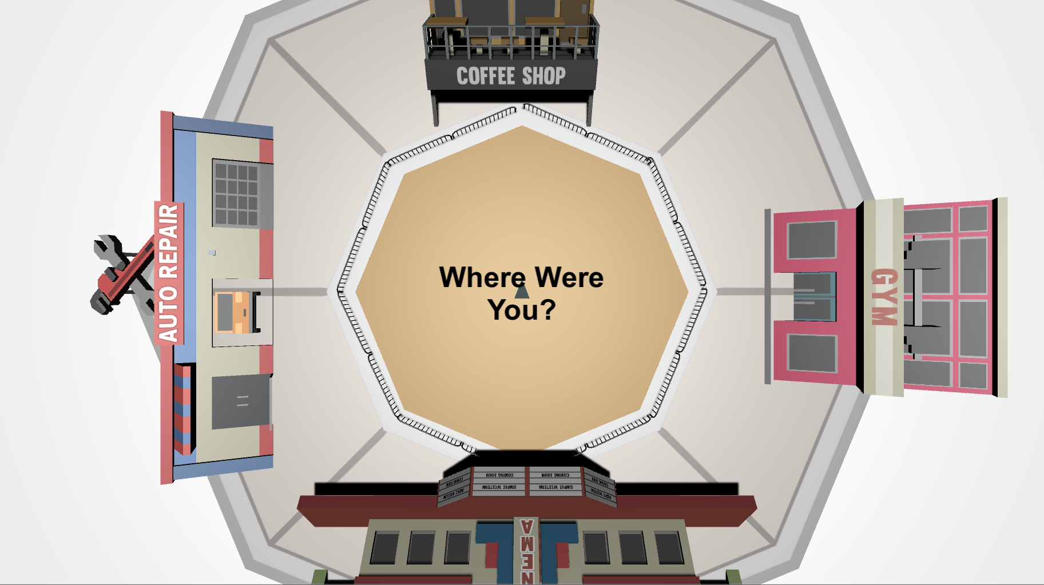
Section 1: Practice
TOP-DOWN VIEW
While exploring the environment, you will be asked periodically to locate where you were from a top-down viewpoint like the picture below.
The grey triangle in the middle shows the direction that you’re facing, and the controls are the same as the 3D environment. Move the grey triangle to the last position you were in, in the 3D environment, and then press the Spacebar. This might be difficult at first, but you will get better at it each time!
Do you have any questions?

Slide 7
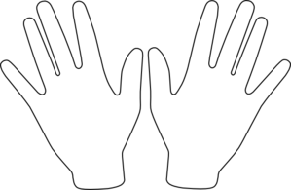
When you’re ready, place your right hand on the arrow keys and press the Spacebar with your left to continue!
Spacebar

Slide 8


Explore The Environment!

Slide 9
Great Work!
Notify the Experimenter that you’ve completed this section

Slide 10
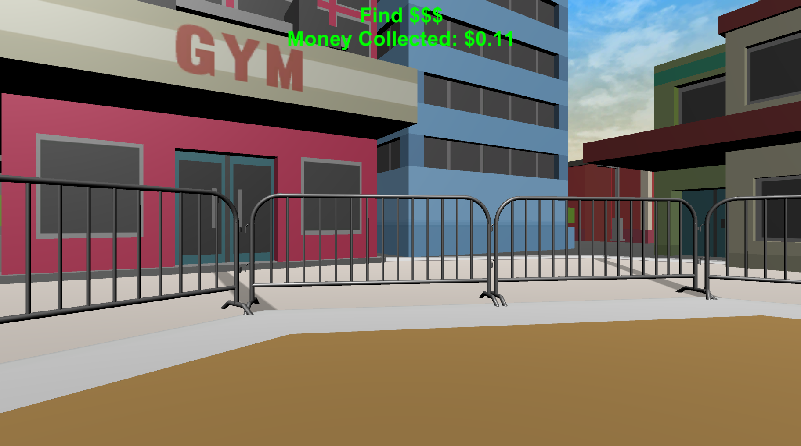

Section 1: Practice
Now you will practice finding money! The money will be invisible but when you find it you will hear a collection sound and it will be added to your Money Collected for each round which you’ll see at the top of your screen.
Do you have any questions?

Slide 11

You should hear a coin sound every time you collect money.
Section 1: Practice
Let’s make sure everything is working correctly! Keep moving around the environment until you collect 10¢! Feel free to adjust your volume as necessary!
Do you have any questions?

Slide 12
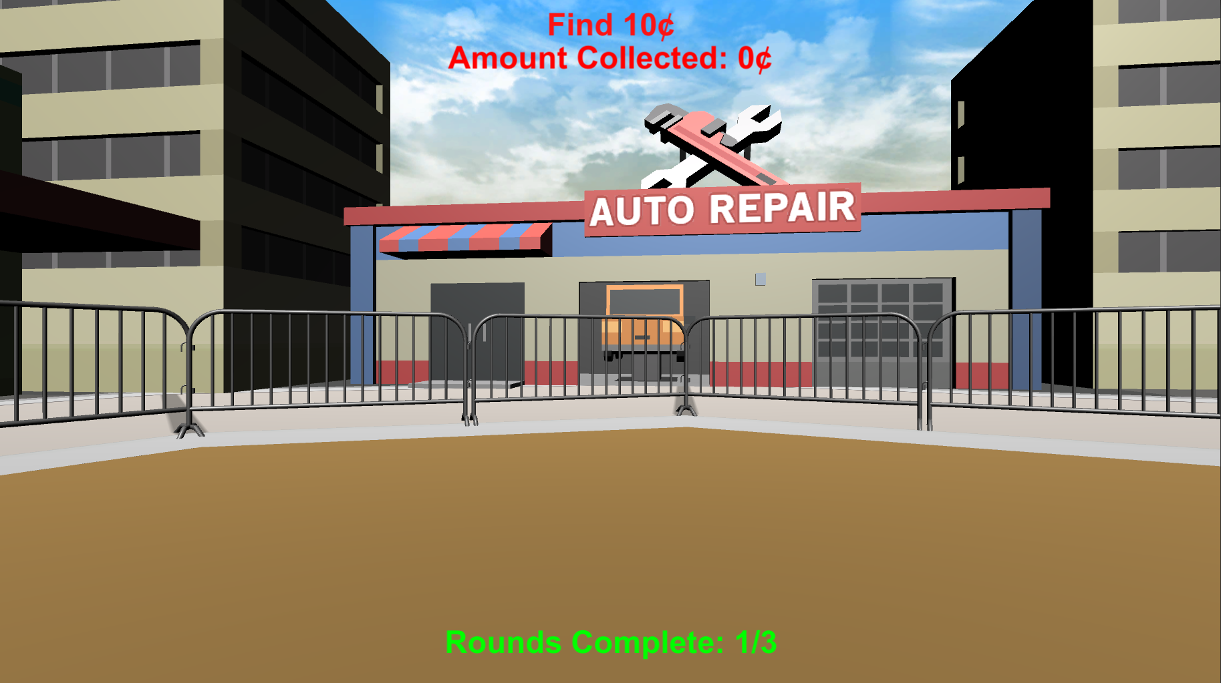
Section 1: Practice
Now that you know how to find money, your your next task is to practice finding it as fast as you can! On each of the following rounds, you be given 1 minute to find 10¢. You can see how much you’ve collected at the top of your screen
If you find 10¢ before the minute is up, the round will end and you will see a point added to the Rounds Complete at the bottom of the screen. In order to proceed to the Bonus Section of the experiment you must find 10¢ on 3 Rounds. You will be given 16 rounds to do this!
Do you have any questions?

Slide 13

Section 1: Practice
Before the start of most rounds you will see the “Search For Money” screen.
During these rounds you will hear a coin sound every time you collect money and you will be able to see how much you’ve collected at the top of the screen!
If you collect 10¢ before the minute is up the round will end and a point will be added to your Rounds Complete total
Do you have any questions?

Slide 14

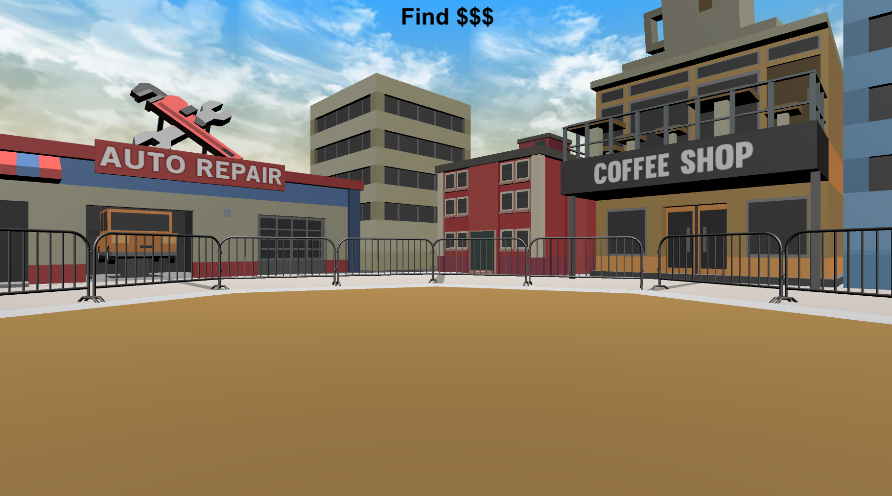
Section 1: Practice
Before the start of some rounds you will see the “Search For Money! NO FEEDBACK” screen.
During these rounds you will NOT hear a coin sound when you collect money and you will NOT be able to see how much you’ve collected!
Just like in the other rounds, if you reach 10¢ the round will end and a point will be added to your Rounds Complete total.
HINT: Use what you’ve learned from the Feedback Rounds to guide your search!
Do you have any questions?

Slide 15
Let’s try doing a Feedback Round and a No Feedback Round together!
When you’re ready, place your right hand on the arrow keys and press the Spacebar with your left to continue!
Spacebar

Slide 16

Section 1: Practice
Do you have any questions about the Feedback and No Feedback rounds?
You will now complete the remaining rounds on your own. Remember, you must collect 10¢ on 3 rounds in order to move on to the Bonus Section of the experiment.
At the end of this section you will be instructed to notify the experimenter
Press Spacebar to continue …

Slide 17


Search For Money!

Slide 18
Search For Money! NO FEEDBACK

Slide 19
Great job!
You’ve completed the PRACTICE section!
PLEASE NOTIFY THE EXPERIMENTER!!!
let’s move on to the BONUS PAY section!
Practice
Bonus Pay
Find The Trophy
Experiment Survey
press Spacebar to continue …

Slide 20
The three slides below are for the version with threshold. You can ignore them for now.

Slide 21
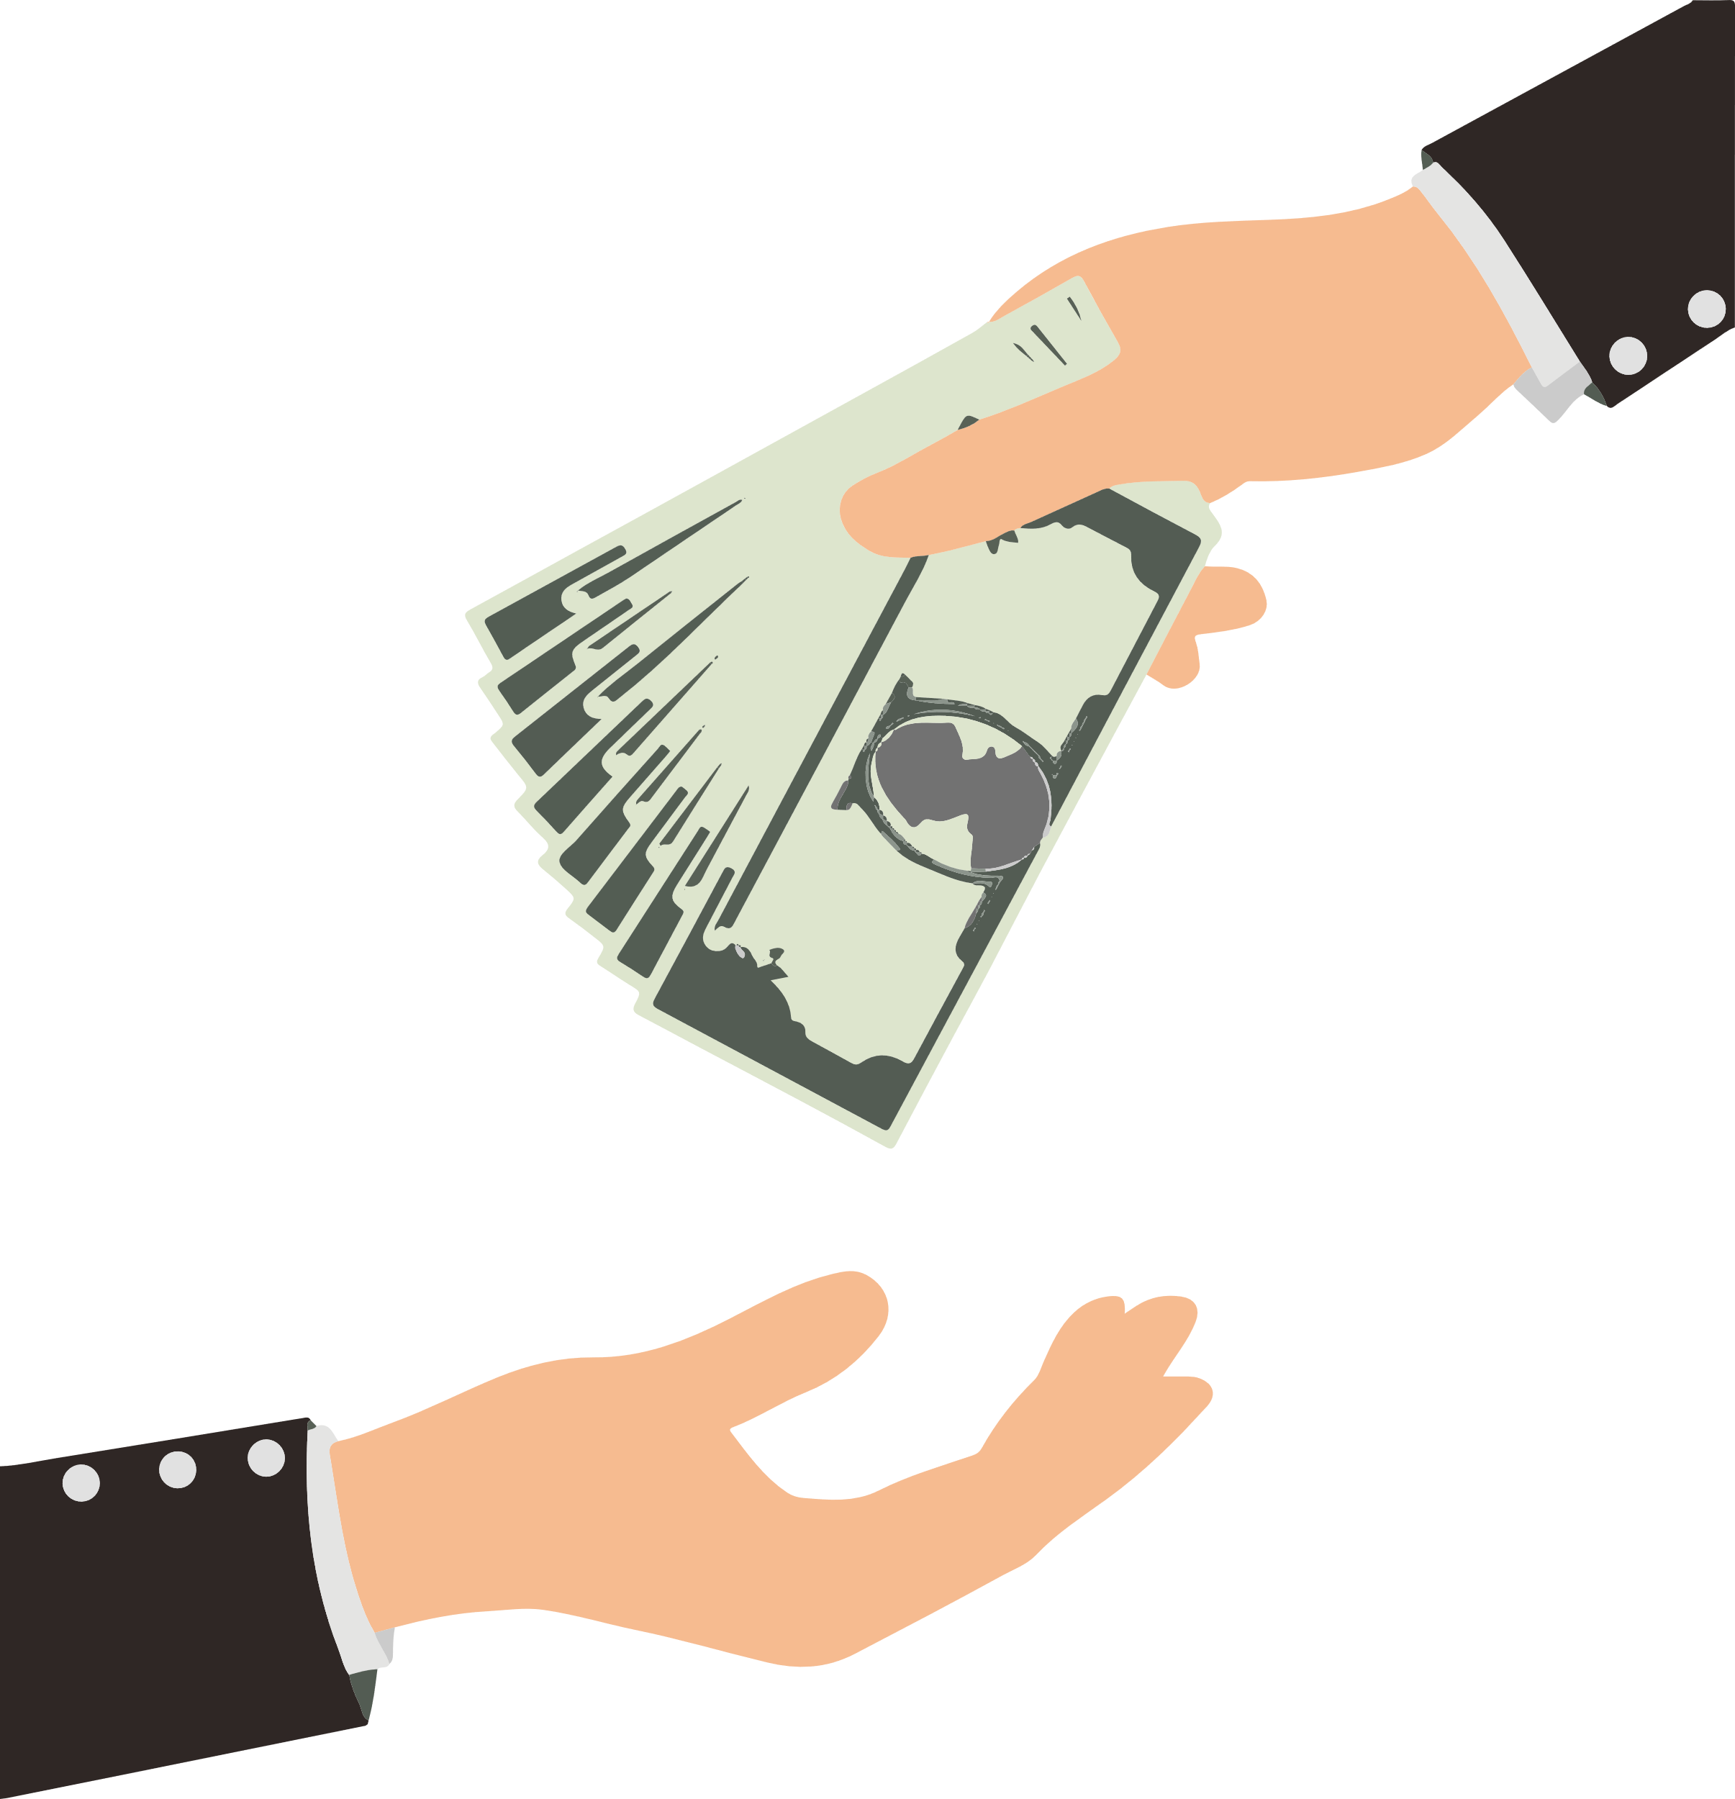
BONUS PAYMENT
There is an UNLIMITED amount of money to collect in each round. You need to collect XXX in at least 3 out of 12 rounds to proceed to the next phase of the experiment. The money you collect you will receive as a BONUS PAYMENT at the end of the experiment! So try to collect as much as possible on each round!

Slide 22
You reached the threshold!
Please notify the Experimenter.

Slide 23

Unfortunately, you didn't reach threshold.
Please notify the Experimenter.

